Slide 1
A DAY IN THE LIFE OF A NITTANY LION
Penn State Harrisburg
Clara Scholz and Nicole Courtney
C

Slide 2
CAREER STUDIES PROGRAM
An inclusive two-year, four-semester program that includes academic and social enrichment, career exploration, and practical work experiences.
Designed for individuals with intellectual and other developmental disabilities.
Students are typically between the ages of 18 and 25.
C & N

Slide 3
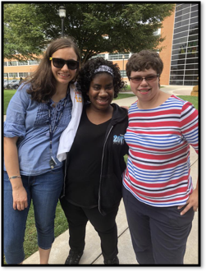
Why I Wanted To Be A Nittany Lion
Clara
My dad went to Penn State
I wanted to prepare for a job
Wanted to be more independent
Wanted to live with roommates
Wanted to make new friends
Nicole
Interesting program at Penn State
Wanted a smaller college
Wanted to focus on what I can do
Wanted to take interesting classes

Slide 4
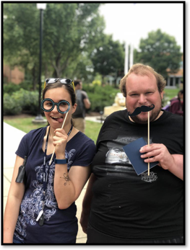
Best Parts of College
Clara
Take lots of classes
Lots of activities to do each week
Career Studies has become a second family
Nicole
Peer mentors become like siblings
Making Friends
The faculty and staff are super nice

Slide 5
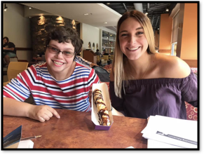
Favorite Places on Campus
Clara
Soccer Field – Soccer Manager
Stacks – Delicious Food
CUB – exercise
Nicole
SEC – Interesting People, comfy couches, & ice cream
Outside – dogs, people, & its beautiful

Slide 6
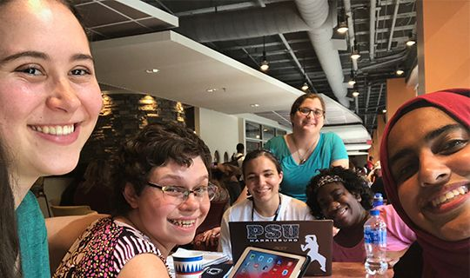
Classes
Classes can be difficult
We get to be with other students
A mentor comes with us to class
There are lots of books for classes
We have many assignments
We take tests and quizzes
We get to be with other students
We get to have multiple professors
Clara
Personal Defense
Yoga
Perspectives on Aging
Fundamentals of Acting
Infancy and Childhood
Intro to Human Development
Women & the American Experience
Nicole
Sociology
Criminology
Introduction to Western Music
Introduction to Acting
Urban Sociology
C

Slide 7
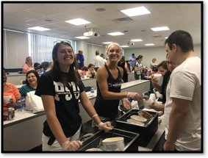
CAMPUS EVENTS
You have to sign up
Lots to choose from
Most are fun
Gain information
Meet new people
Most are free
Clara
Women’s Soccer Manager
Fall Fest
Caricatures
DUI Demonstration
Massage Day
Nicole
Spring Luau
Cake Decorating
Wellness Fair
Speaker – Graham Hetrick
Ice Cream Social
N

Slide 8
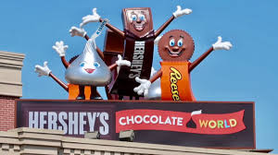
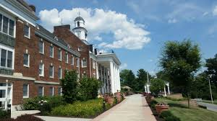
JOB SHADOWS
Go to a business
Do during our first year
Observe the employees
Learn about the positions
Figure out what you like & do not like
Dress business casual
Sort of like a field trip
Reflect on our experience to help us know what job we may like
Thank you notes
We Went:
Hershey Chocolate World
Hershey Gardens
Hershey Country Club
Hershey Lodge
Middletown Nursing Home
Adventure Sports
Homeland Nursing Home
N

Slide 9
PRACTICUMS
Practice for employment
Get experience in a job you like
Get evaluate
We have a job coach or mentor
We do not get paid
Nicole
Penn State Harrisburg Alumni and Development Office
I like the people I work with and learning how to do office tasks. I also like that I can walk to my practicum because it is on campus.
Clara
Middletown Nursing Home
I like that I talk to the residents and see how there day is going. I also like to help out with the activities.
C

Slide 10
Job Skills I Have Learned
Clara
Listening Skills
Learning more about me
Asking for directions or help
Dressing professionally
Advocating for myself
Nicole
How to be professional but social
Respect
Resume Skills
Job Interest
Asking what to do next
C & N

Slide 11
FUTURE GOALS
Clara
My plan is to get a full time job working with seniors.
I want to get an apartment with my girlfriends.
I want to get married and live independently.
I would like to have two cats.
I would like to adopt four kids.
Nicole
My plan is to work in the office of development and alumni at Penn State Harrisburg.
I want to get married and live independently.
I plan to have many dogs

Slide 12
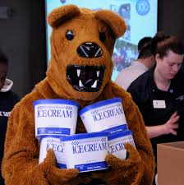
WHY I LOVE BEING A NITTANY LION
Clara
I have a second family.
There are nice professors here.
I like meeting new friends and mentors.
I like taking different classes.
Nicole
Everyone at Penn State is kind & friendly
I love my mentors.
The ice cream is awesome!

Slide 13
Thank You!
Questions?

