Slide 1
Success Engagement Education Determination
Claudio Zaffarese

Slide 2
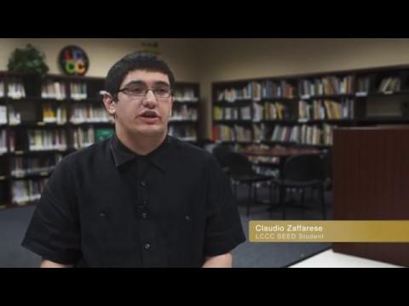

Slide 3
Why College

Slide 4
Classes Attended
Earned an A
Color Theory
Painting 1
Two Dimensional Design
Drawing 1 & 2
Principles of 3D Modeling and Texture
Earned a B
Digital Design
Earned a C
Digital Photography

Slide 5
Classes Attending
Motion Graphics
Intro to Animation
Intro to Music

Slide 6
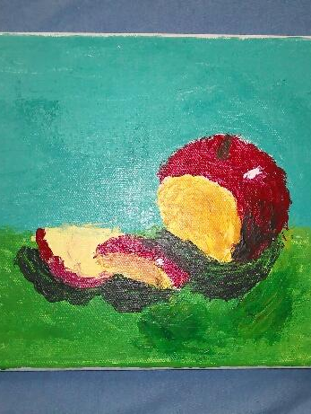
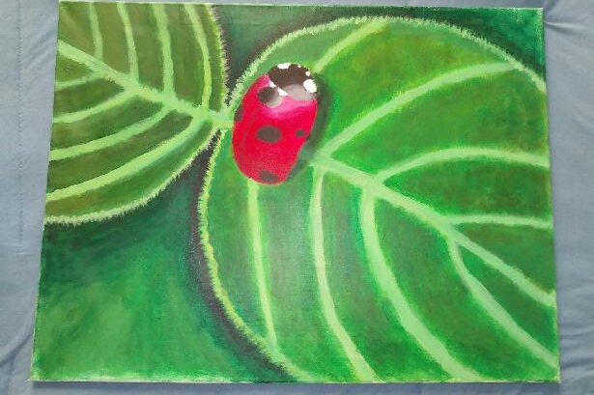
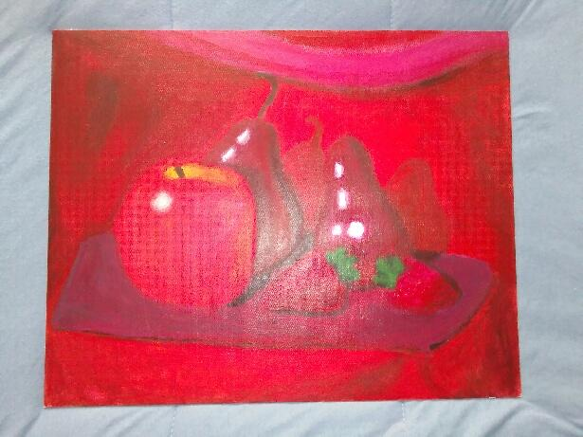
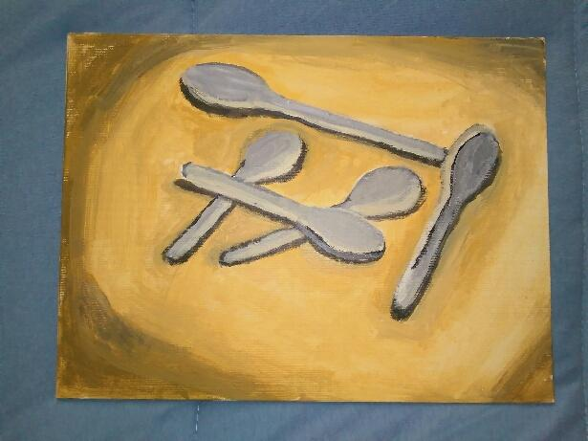
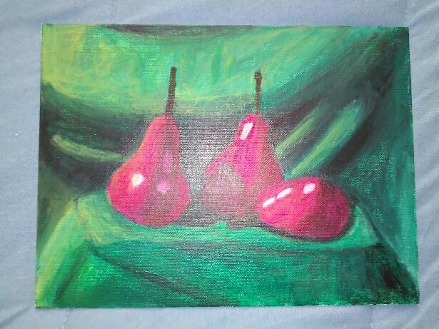
My Artwork

Slide 7
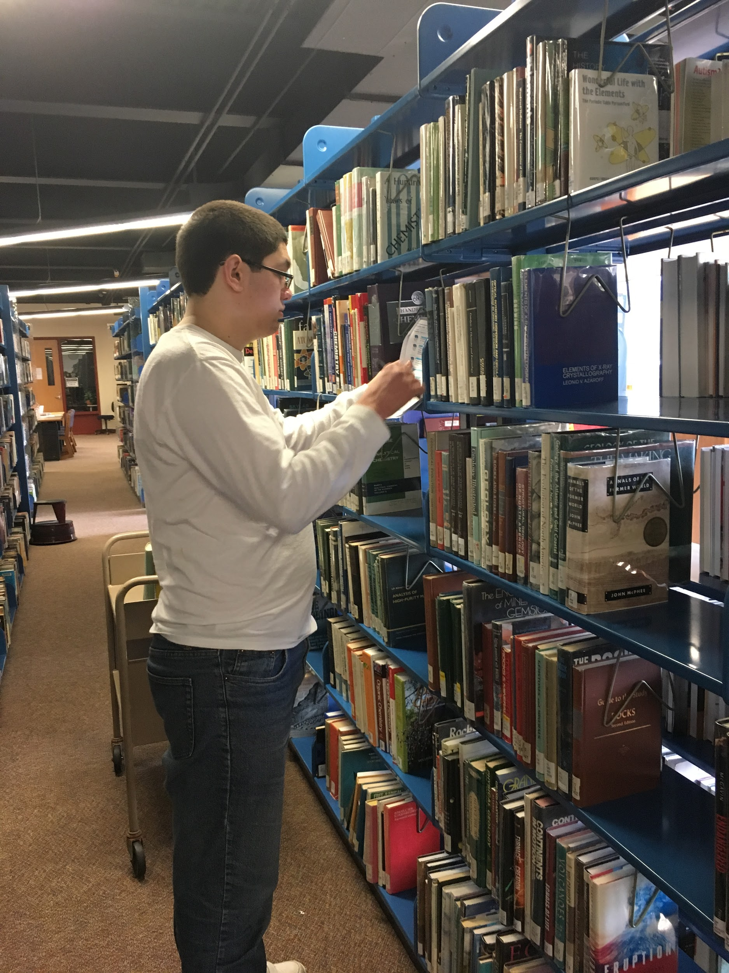
Clubs
&
Work

Slide 8
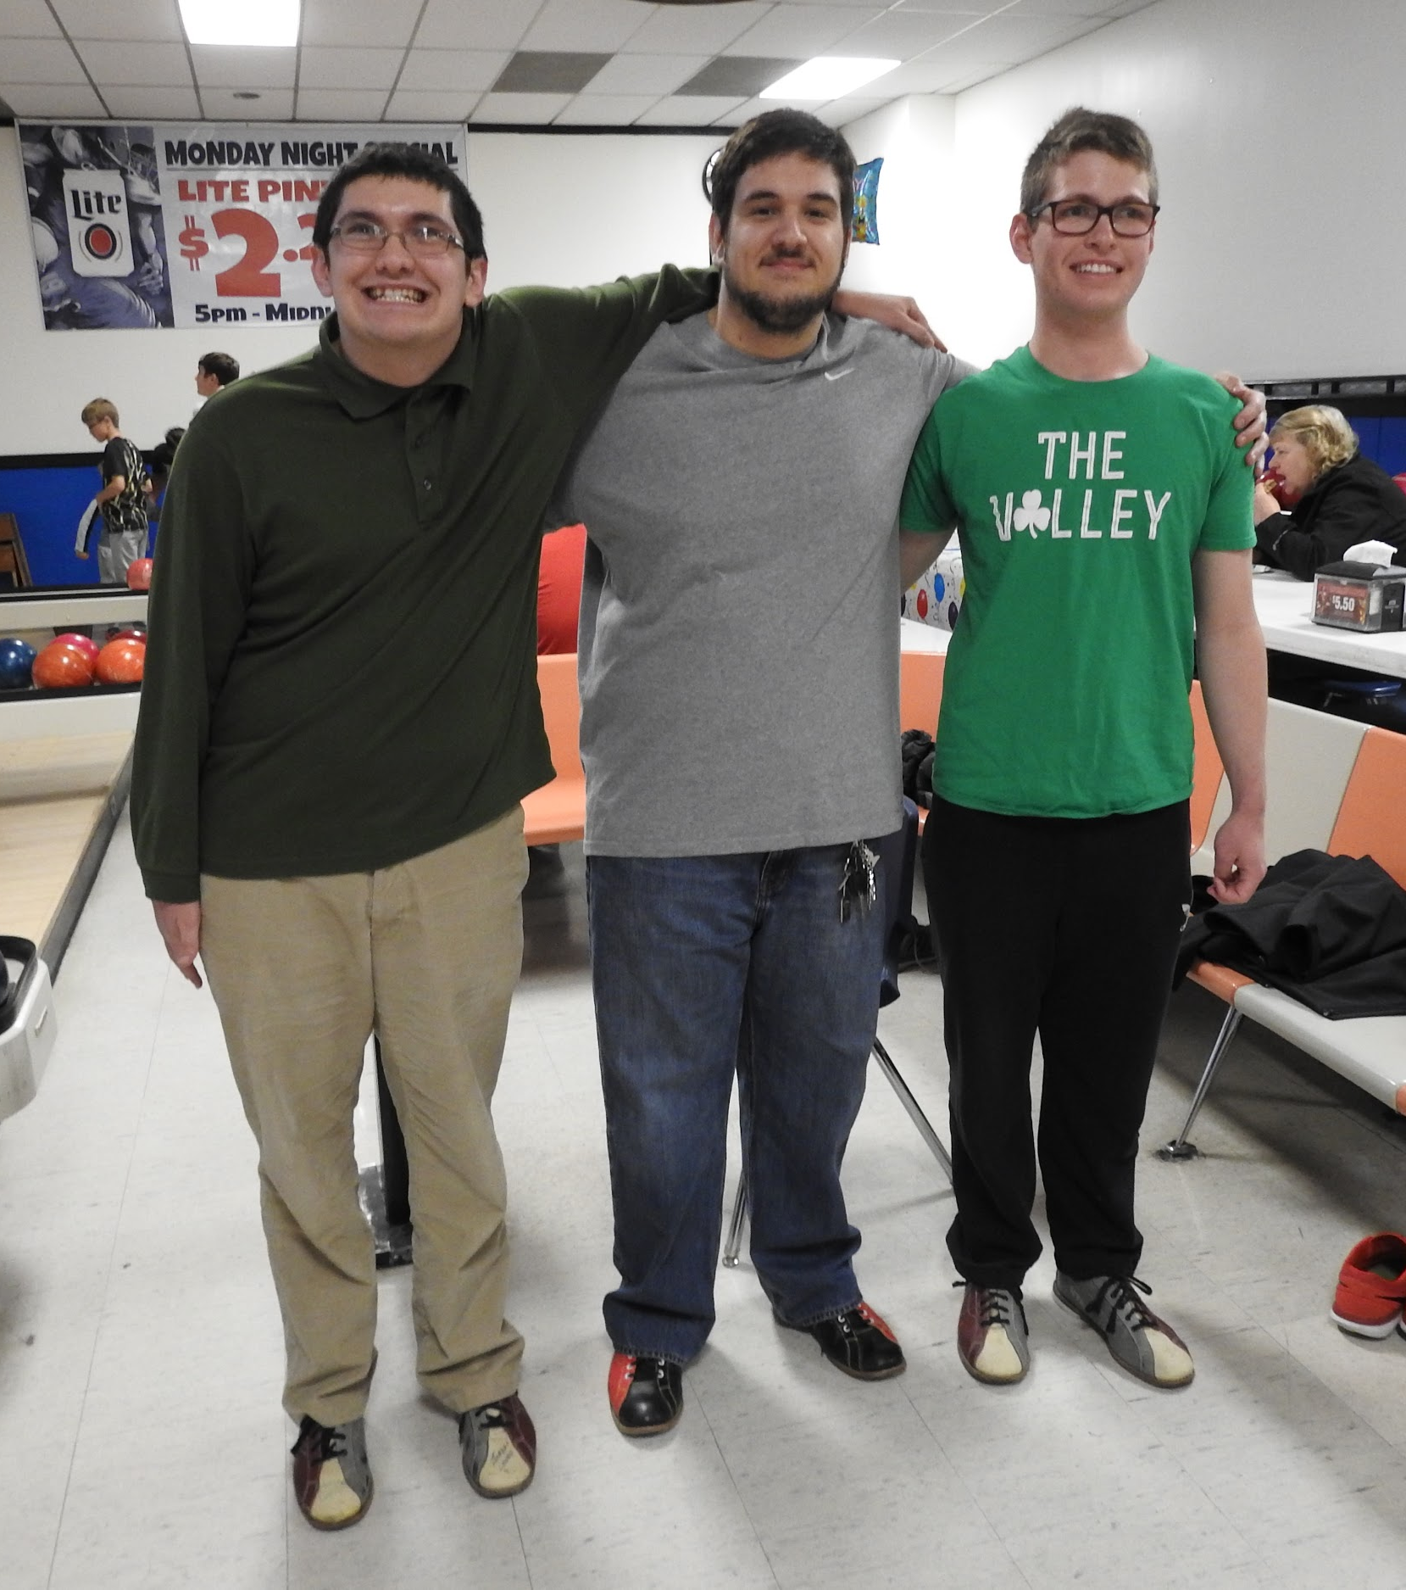
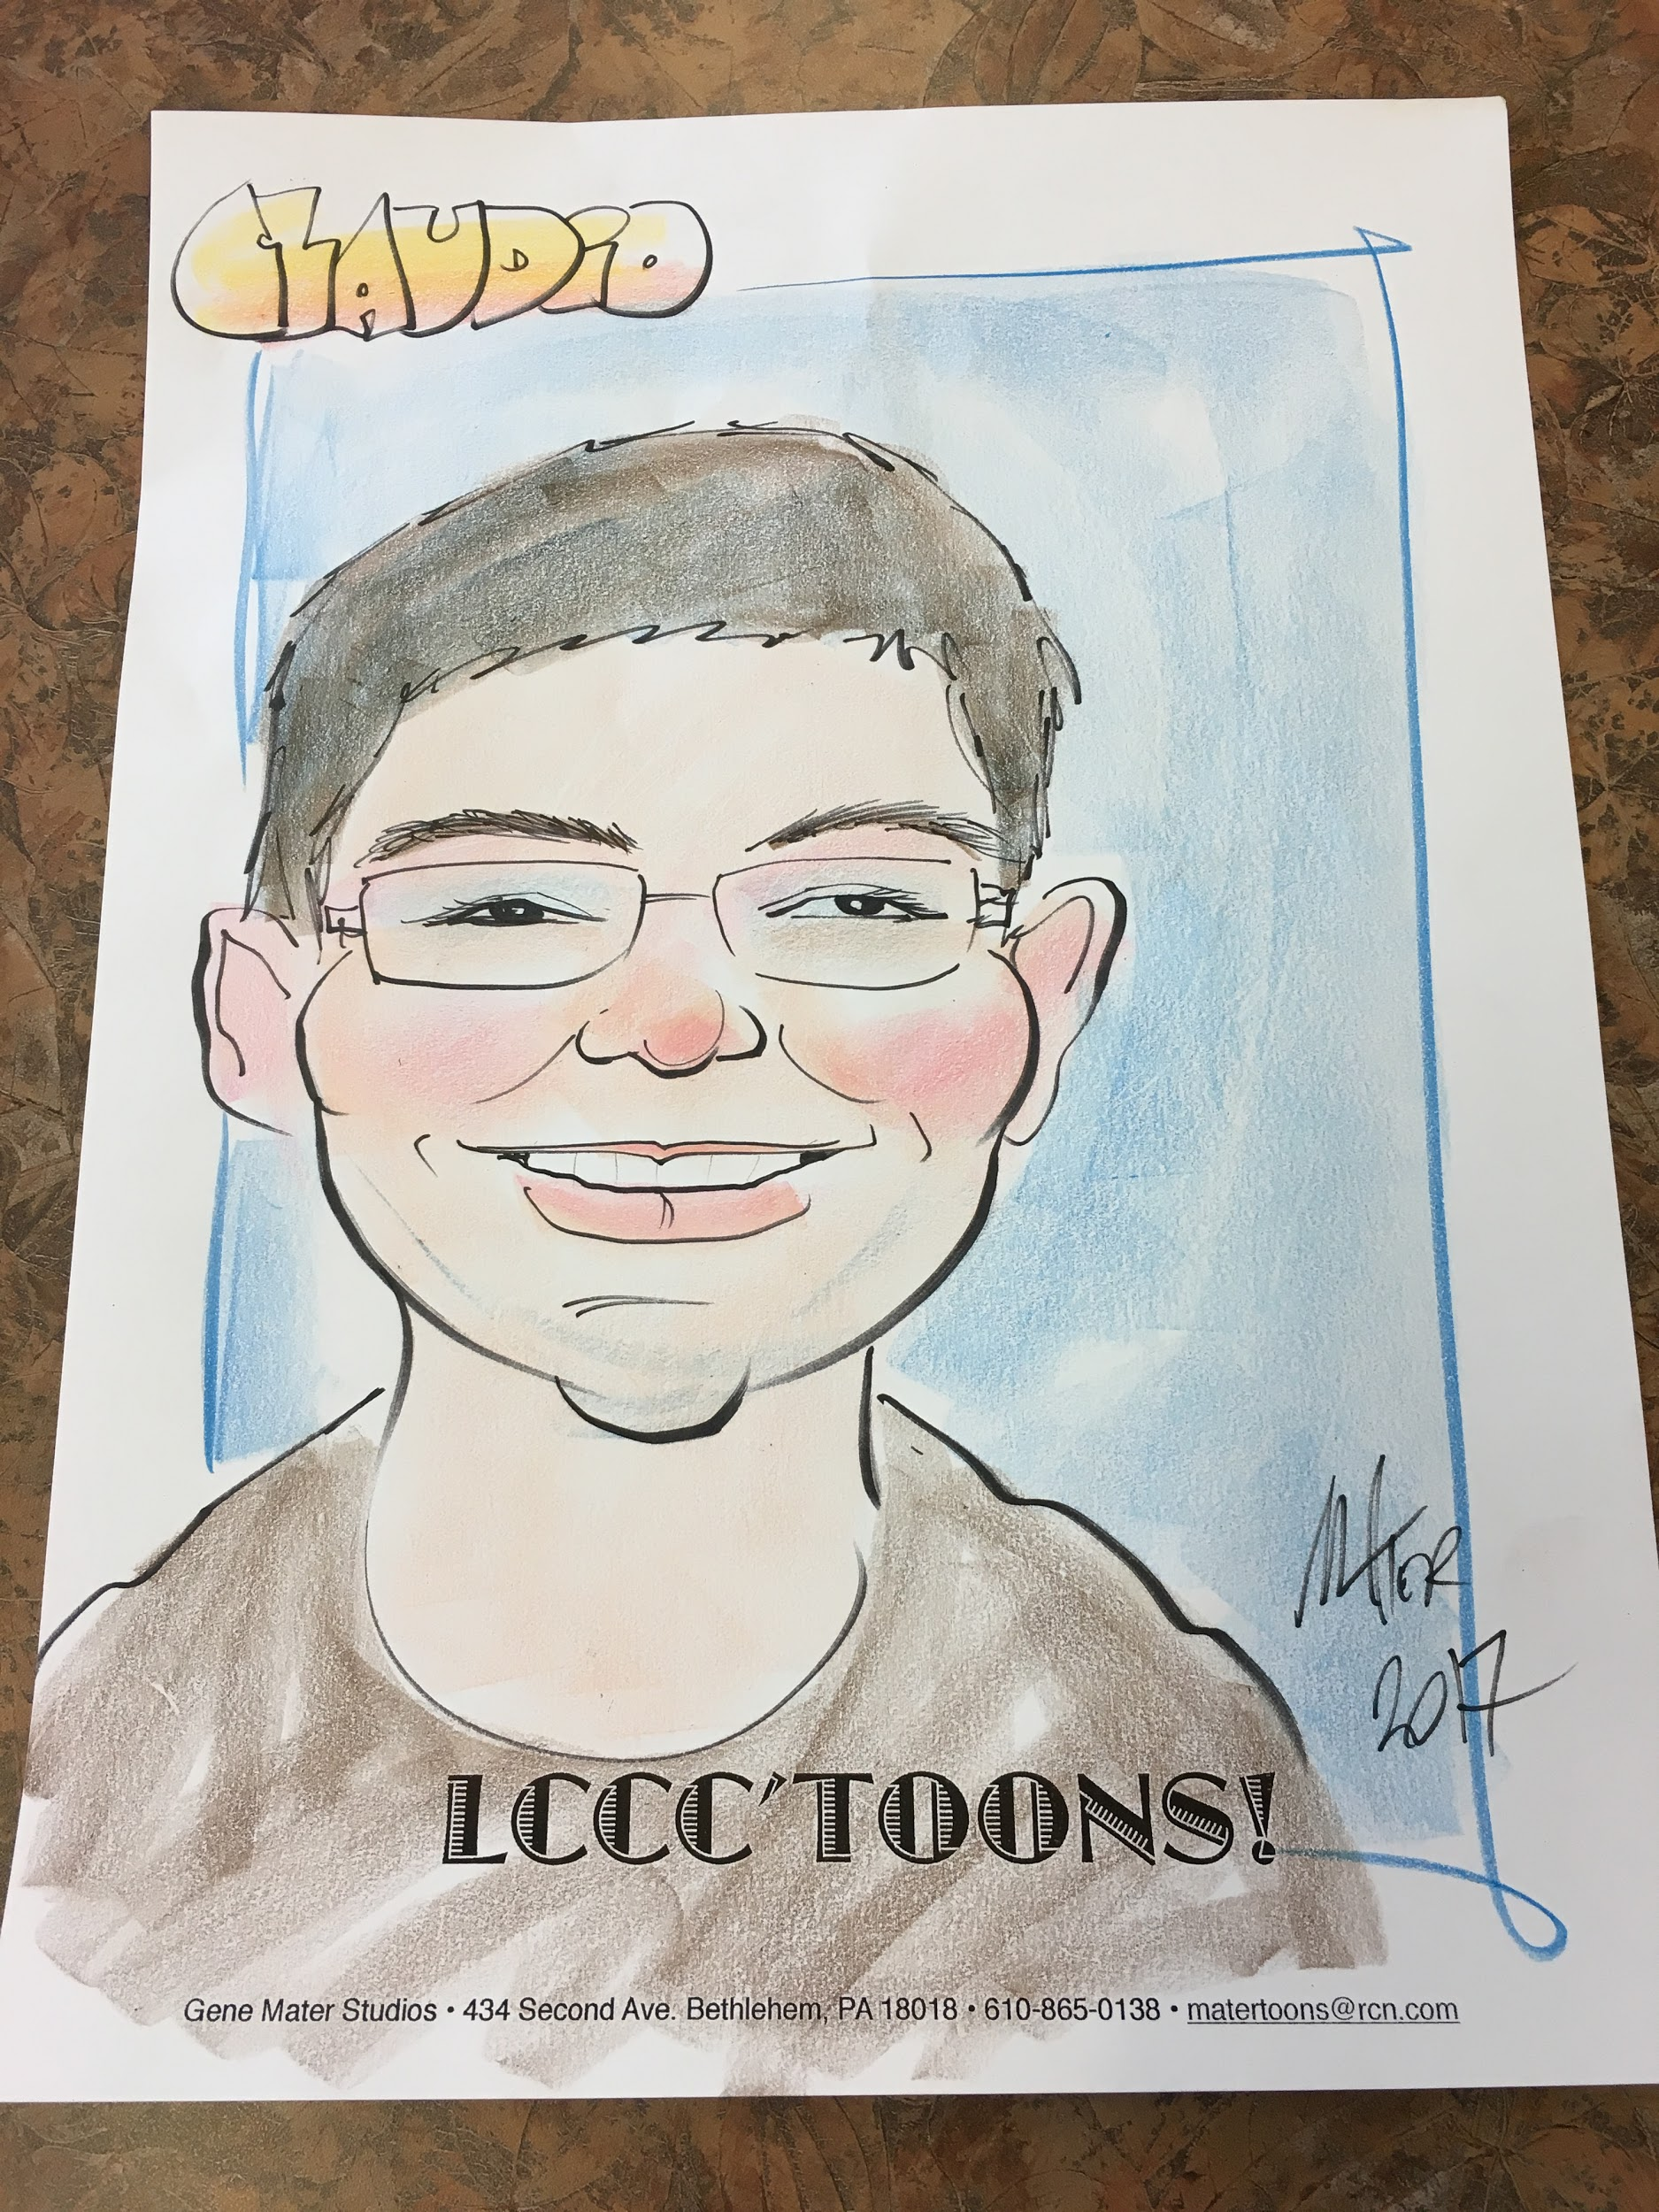
Social Activities

Slide 9
Typical Day

Slide 10
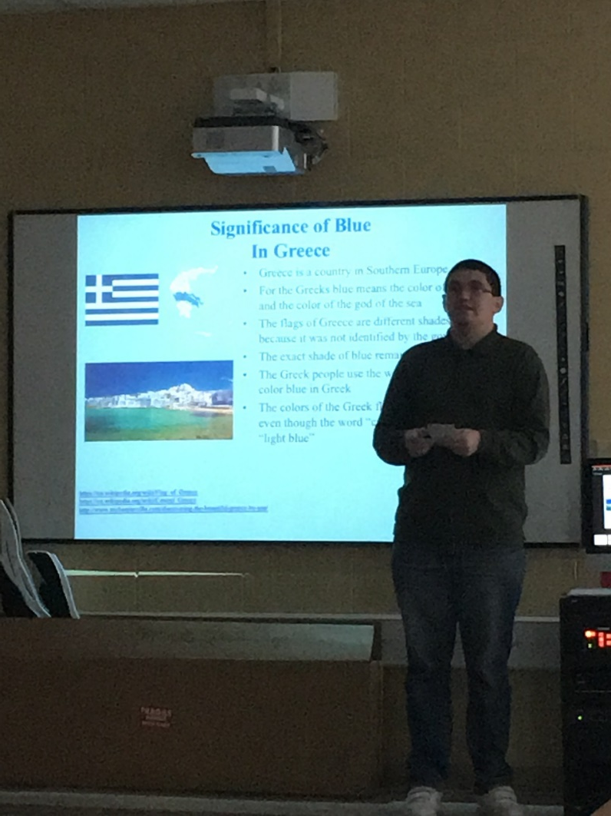
What College Has Taught Me
Public Speaking

Slide 11
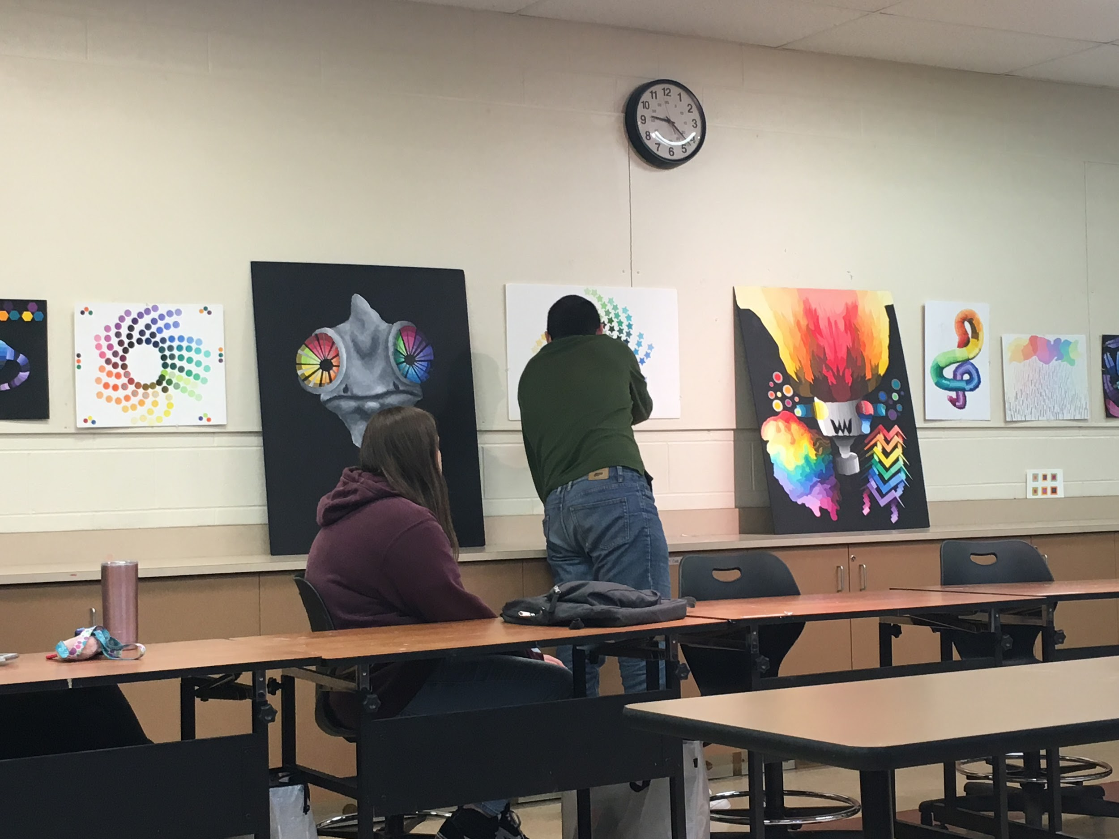
What College Has Taught Me
Teamwork

Slide 12
Future Plans

